Slide 1

The Geometry of Virtual Worlds
CS 498VR: Virtual Reality
UNIVERSITY OF ILLINOIS AT URBANA-CHAMPAIGN
Eric Shaffer

Slide 2
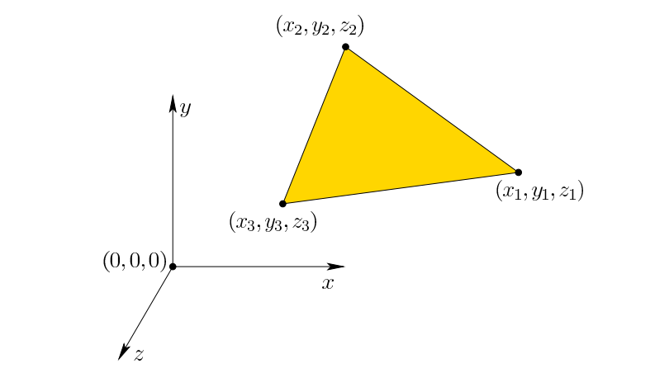
Modeling a Virtual World
As you likely already know (start MP1!)… …software like Unity lets you build a geometric model of a 3D world.
It’s a like a digital version of drawing on graph paper by hand…
Most models are surfaces that are composed of a mesh of triangles

Slide 3
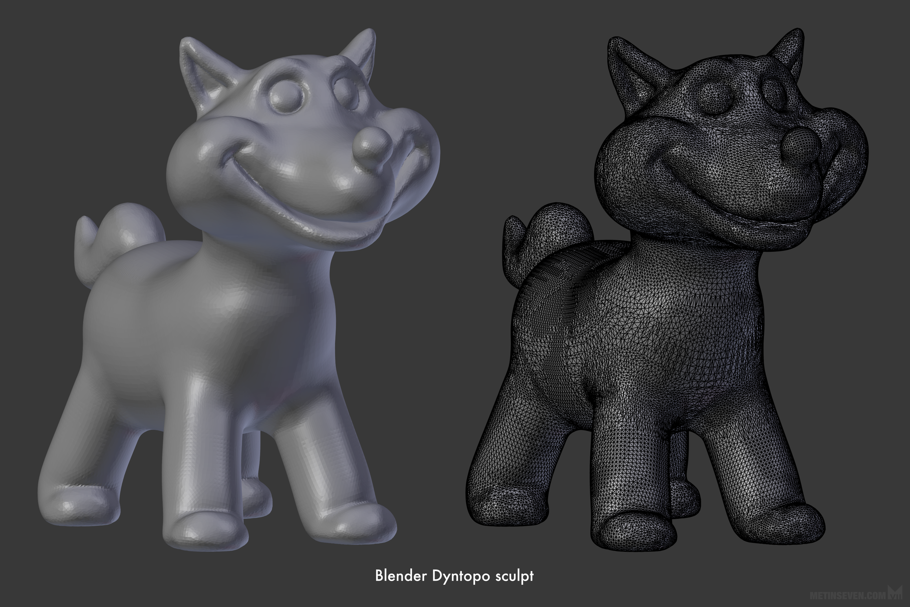
Meshes of Triangles
Why triangles? Anyone have any suggestions as to why they are so popular for modeling?
Any other ways we could represent shapes?

Slide 4
Geometric Modeling Fundamentals…
We will discuss basic geometric modeling for 3D computer graphics
As the book says…. It’s easier to use tools when you know how they work.
If you work with high-level engines to build a VR experience, then most of the concepts from this chapter might not seem necessary. You might need only to select options from menus and write simple scripts. However, an understanding of the basic transformations, such as how to express 3D rotations or move a camera viewpoint, is essential to making the software do what you want. - S.M. Lavalle, Virtual Reality

Slide 5


How DO You Generate a Mesh?
Often generated using a modeling tool like Maya or Blender
Both freely available
Export your model as file…..
Import it into Unity…..

Slide 6
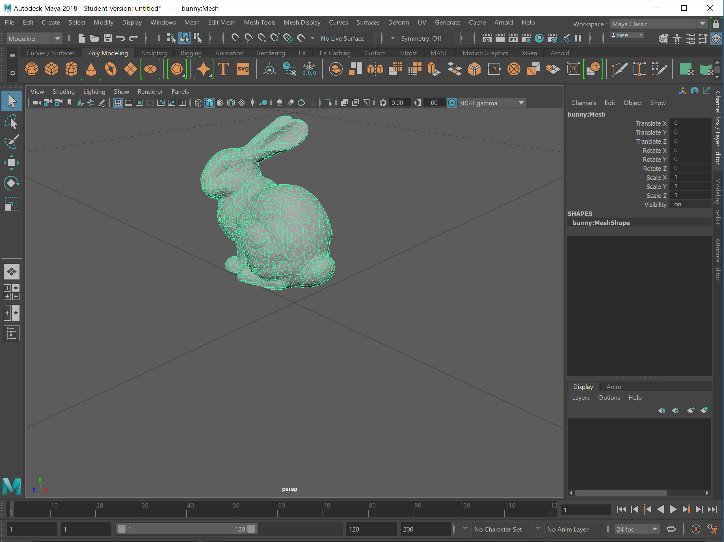
Maya…

Slide 7
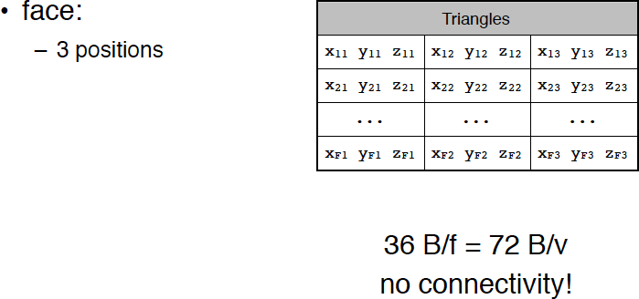
What Doe Mesh Data Look?
Lots of different file formats….
One of the first (as in “this is ancient”) was the STL format
Each line of the file specifies the 3 corners of a face (triangle)

Slide 8
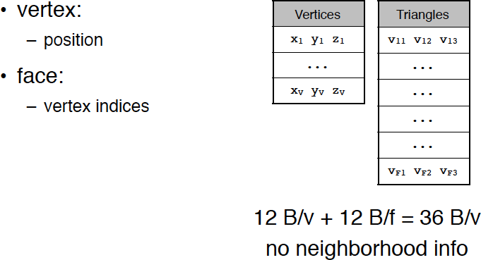
Mesh Data Structure: Indexed Face Set (OBJ)
The OBJ file format is a popular storage format for meshes
Developed by Wavefront Technologies…now part of AutoDesk
Text files with .obj extension
# List of geometric vertices v 0.123 0.234 0.345 1.0 v ... v ...
# List of triangles f 1 3 4 f 2 4 5
…

Slide 9
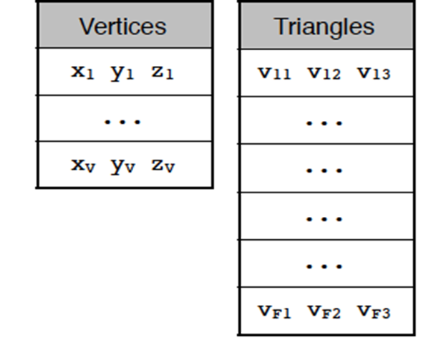
Indexed Face Set
Can be used for offline storage…a file format
Or can be used as an internal data structure
One block of data are the vertices
Each vertex is a set of 3 coordinates
Often referred to as the geometry of the mesh
Another block of data is the set of triangles
Each triangle is set of 3 integers vertex IDs
The vertex IDs are indices into the vertex block
What are some advantages of this representation?

Slide 10
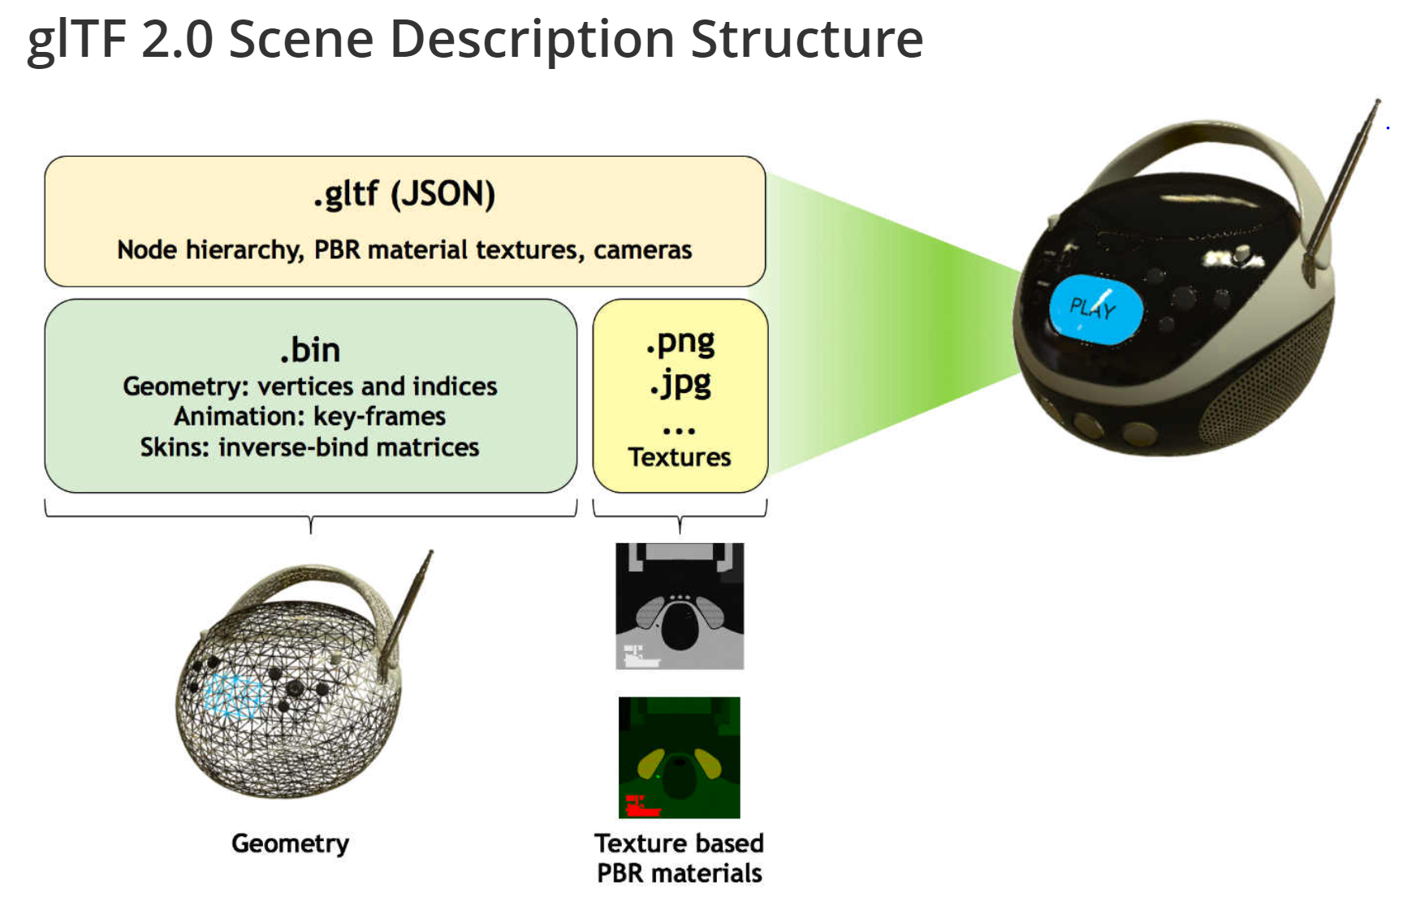
A Modern 3D Format for the Web: glTF
Designed for real-time asset delivery on the web
Whole scene description… including meshes

Slide 11
Coordinate System of Our Virtual World
Origin is at (0,0,0)
Units are…something
Thinking of them as meters is usually convenient for mimicking real world
Coordinate system can be left or right-handed
Unity is left….
3.js and A-Frame are right (sort of)…

Slide 12
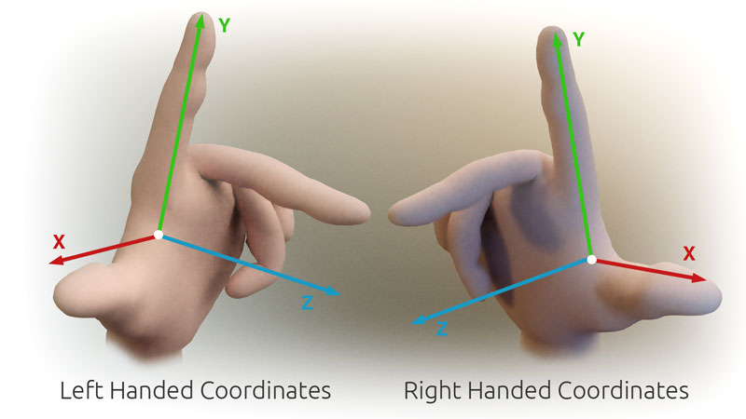
Handedness….
Which is +Z in relation to +X and +Y ?

Slide 13
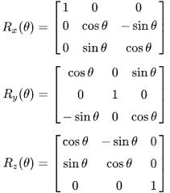
Making Things Move….
We already know enough to define a static scene…
How do we make geometry move?
How do we make our viewpoint move? Both of these are usually accomplished using linear transformations So…we’ll look at how we can encode transformations as matrices
Actually…to be accurate….moving geometry is usually done using affine transformations.

Slide 14
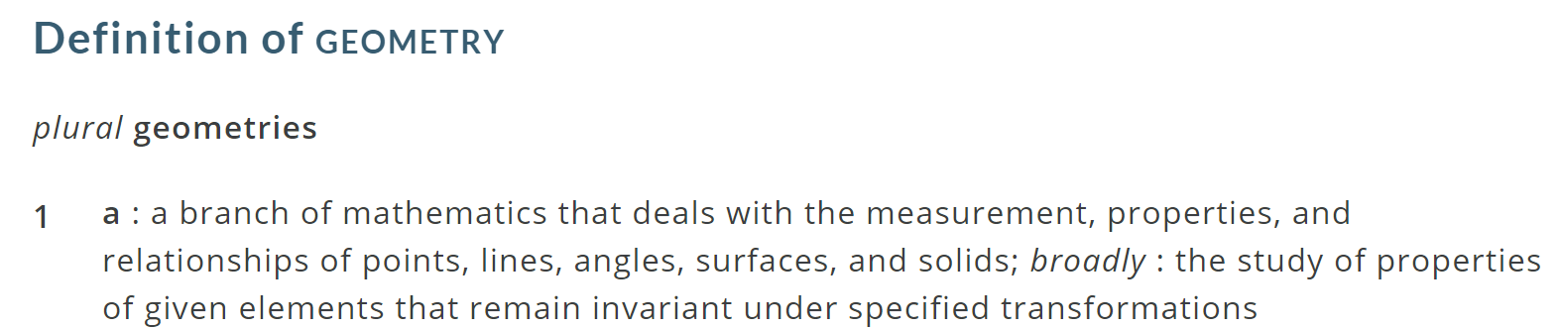
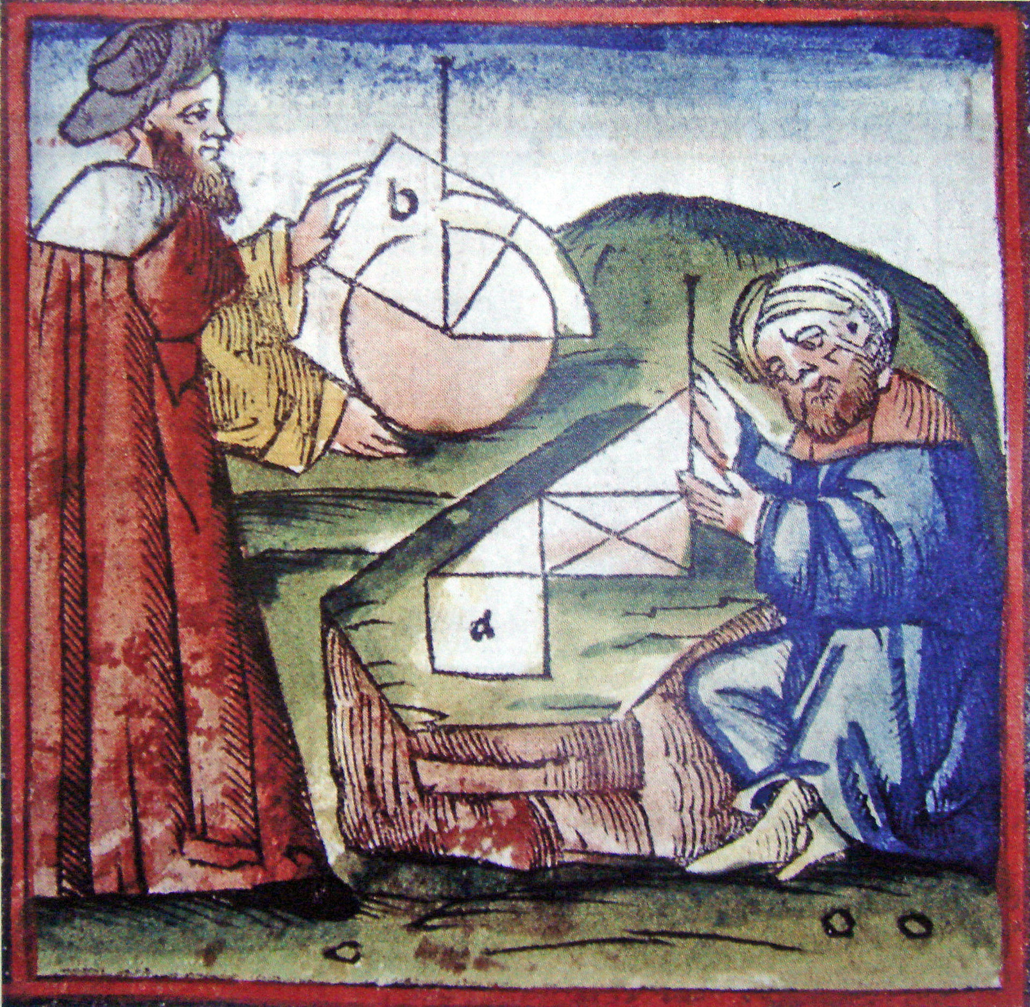
A Brief Sampling of Useful Math
We will look at three basic geometric elements Scalars: Encode a magnitude Vectors: Encode a magnitude and direction Points: Encode a position in space

Slide 15
Scalars
Scalars are quantities which express only a magnitude… Think of them as just a single number like 3.14
Scalars:
members of a set which
can be combined by two operations (addition and multiplication)
obey some fundamental laws (associativity, commutativity, inverses)
Examples include the real numbers
under the ordinary arithmetic rules with which we are familiar
Scalars have no geometric properties

Slide 16
Vectors
A vector is a quantity with two attributes
Direction
Magnitude
Examples include
Force
Velocity
Directed line segments
v

Slide 17
Vector Operations
Every vector has an inverse
Same magnitude but points in opposite direction
Every vector can be multiplied by a scalar
There is a zero vector
Zero magnitude, undefined orientation
The sum of any two vectors is a vector
Use head-to-tail axiom
v
w
v
-v
αv
u

Slide 18
Operations on Vectors
Scalar-vector multiplication u = αv
Vector-vector addition: w =u + v
Allows expressions such as v=u+2w-3r
Vectors lack position …need points to make things interesting

Slide 19
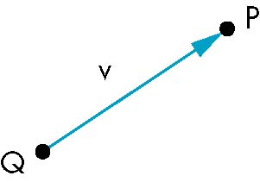
Points
Location in space
Operations allowed between points and vectors
Point-point subtraction yields a vector
Equivalent to point-vector addition
P=V + Q
V = P - Q

Slide 20
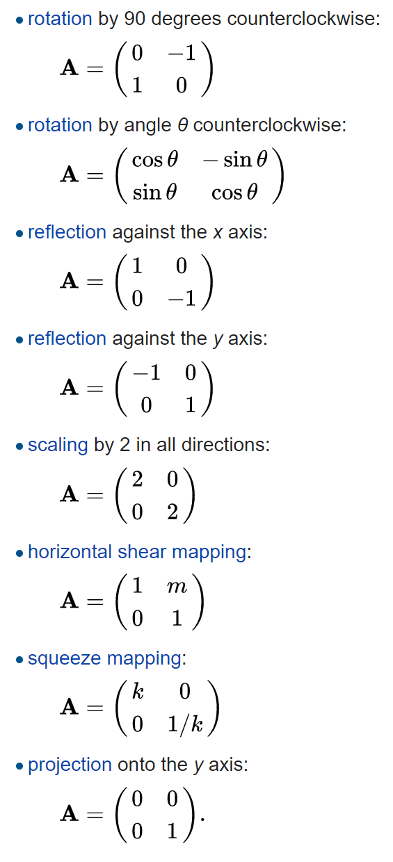
Linear Transformations
Technically a transformation f is linear if
$$f(au+bv)=af(u)+bf(v)$$
for vectors u and v and scalars a and b.
Linear transformations have a geometric interpretation and can be applied to points or vectors.
In two-dimensional space R² linear transformations are described by 2 × 2 real matrices.

Slide 21
2-D Points
(1,1)
Represents points and vertices as column vectors:
(-1,-1)

Slide 22
2-D Points
(1,1)
Represents points and vertices as column vectors:
Transform polygonal object by transforming its vertices
(-1,-1)

Slide 23
2-D Points
(1,1)
Represents points and vertices as column vectors:
Transform polygonal object by transforming its vertices
Scale by matrix multiplication
(-1,-1)

Slide 24
2-D Points
(1,1)
Represents points and vertices as column vectors:
Transform polygonal object by transforming its vertices
Scale by matrix multiplication
Translation via vector sum
(-1,-1)

Slide 25
Squash & Stretch
Classic animation technique Scale one coordinate by matrix multiplication

Slide 26
2-D Points
(1,1)
Represent points and vertices as column vectors:
Transform polygonal object by transforming its vertices
Scale by matrix multiplication
Translation via vector sum
Order is important
Translate then scale
Scale then translate
(-1,-1)

Slide 27
Homogeneous Coordinates
Translation by vector sum is cumbersome
Add a extra coordinate
Called the homogeneous coordinate
For now, set to one
Translation now expressed as a matrix
Now we can compose scales and translations into a single matrix by matrix multiplication

Slide 28
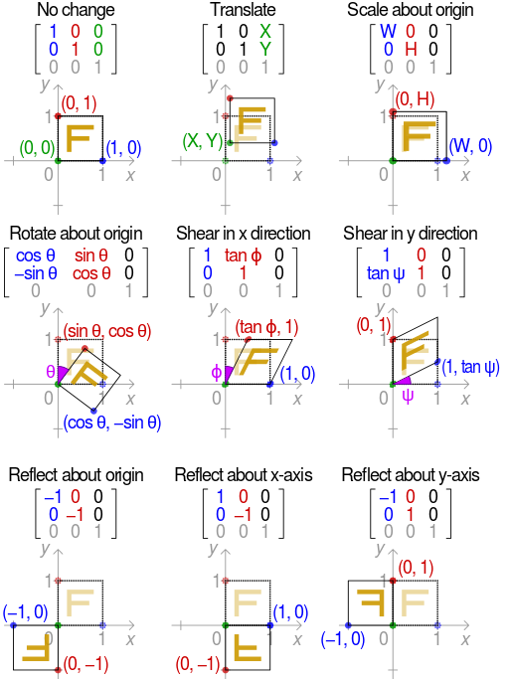
Affine Transformations
An affine transformation is the sum of a linear transformation and a constant vector…
Linear transformations preserve the origin
Translations map the origin to a new position

Slide 29
Order Dependence
(-1,-1)

Slide 30
2-D Rotation
Pick a point (x,y)

Slide 31
2-D Rotation
Pick a point (x,y)
Assume polar coords
x = r cos θ, y = r sin θ

Slide 32
2-D Rotation
Pick a point (x,y)
Assume polar coords
x = r cos θ, y = r sin θ
Rotate about origin by φ
x’ = r cos θ +φ, y’ = r sin θ +φ

Slide 33
2-D Rotation
Pick a point (x,y)
Assume polar coords
x = r cos θ, y = r sin θ
Rotate about origin by φ
x’ = r cos θ +φ, y’ = r sin θ +φ
Recall trig. identities
x’ = r (cosθ cos φ –sinθ sinφ) y’ = r (sinθ cos φ +cosθ sinφ)

Slide 34
2-D Rotation
Pick a point (x,y)
Assume polar coords
x = r cos θ, y = r sin θ
Rotate about origin by φ
x’ = r cos θ +φ, y’ = r sin θ +φ
Recall trig. identities
x’ = r (cosθ cos φ –sinθ sinφ) y’ = r (sinθ cos φ +cosθ sinφ)
Rearrange terms
x’ = cos φ (r cosθ ) – sinφ (r sinθ ) y’ = (r cosθ ) sinφ + (r sinθ ) cos φ

Slide 35
2-D Rotation
x’ = cos φ (r cosθ ) – sinφ (r sinθ )
y’ = (r cosθ ) sinφ + (r sinθ ) cos φ

Slide 36
2-D Rotation
x
y
x’ = cos φ (r cosθ ) – sinφ (r sinθ )
y’ = (r cosθ ) sinφ + (r sinθ ) cos φ
x
y

Slide 37
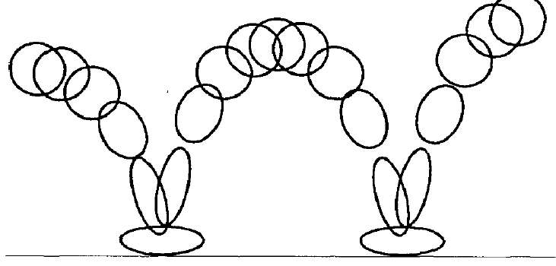
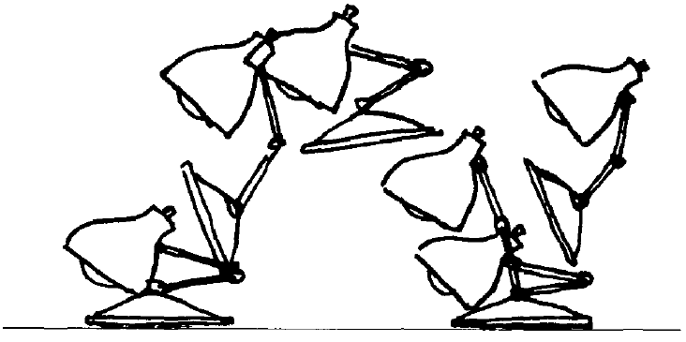
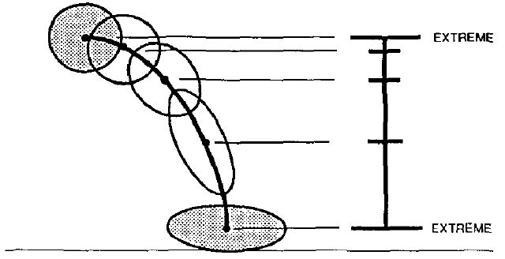
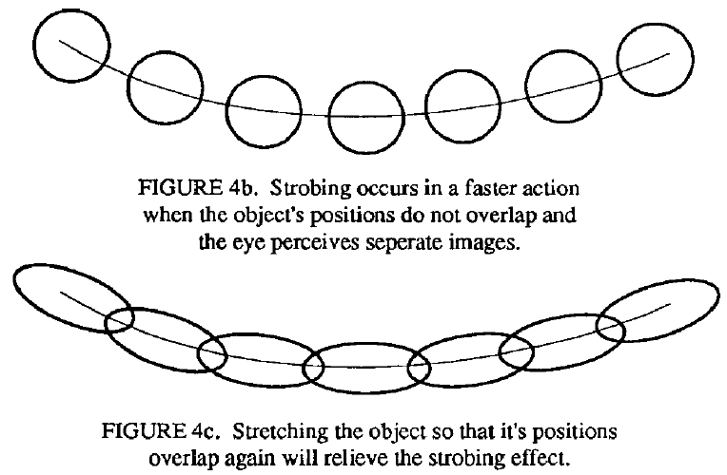
Squash & Stretch
From: John Lasseter: “Principles of Traditional Animation Applied to 3-D Computer Animation” Proc. SIGGRAPH 87

Slide 38
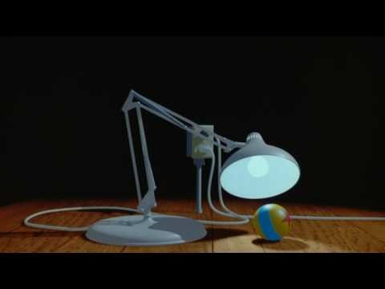
Luxo Jr.
Directed by | John Lasseter
Written by | John Lasseter
Production company | Pixar
Release date | Aug. 17, 1986 (SIGGRAPH)

Slide 39

Luxo Jr.
Breakthrough demonstration of computer animation in 1987
Demonstrates shadow maps and Renderman surface shaders
Lamp and ball behavior implemented using affine transformations
Took about 5 months of work from Pixar’s (then) tiny animation team
It was the first CGI film nominated for an Academy Award.
In 2014, Luxo Jr. was deemed "culturally, historically, or aesthetically significant" by the Library of Congress and selected for preservation in the National Film Registry.

Slide 40
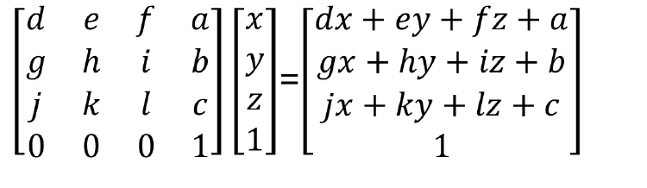
3-D Affine Transformations
General Form (with homogenous coordinates)

Slide 41
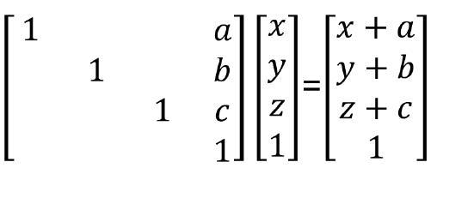
Translation

Slide 42
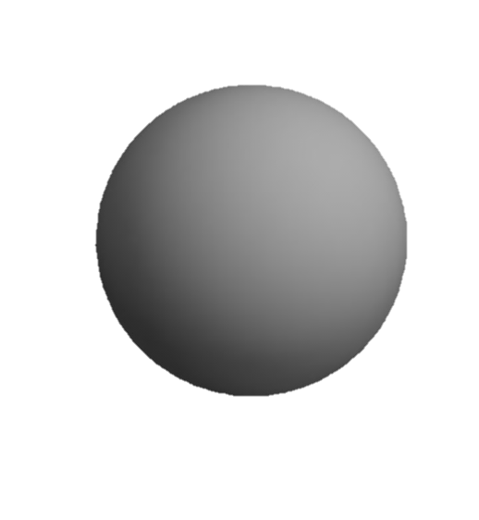
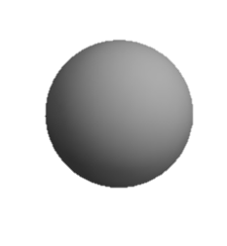
Scale
y
x
z
Uniform Scale
a = b = c = ¼
Stretch
a = b = 1, c = 4
Squash
a = b = 1, c = ¼
Project
a = b = 1, c = 0
Invert
a = b = 1, c = -1

Slide 43
3-D Rotations
About x-axis
rotates y → z
About y-axis
rotates z → x
About z-axis
rotates x → y
Rotations do not commute!

Slide 44
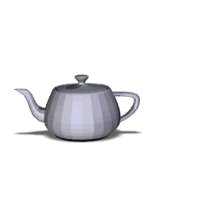
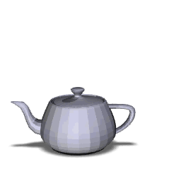
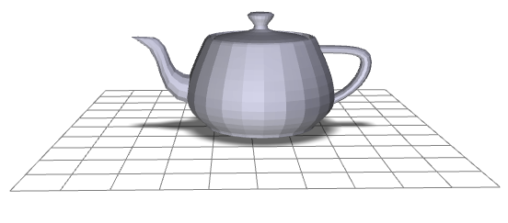
Transformation Order
y
x
z
M
M
M
R
T
T
R

